Slide 1
Data Structures & File Management II
GROUP I
Jodiann Allen 20121358
Gerard Francis 20142119
Bryanna Chang 20112213
Garson Anglin 20142037
Shanika Ferguson 20141916
Schana Beckford 20151316
Christopher Howe 20141522
Mark Dennis 2012686

Slide 2
Task
Write a game program to implement a maze. The program should allow a user to navigate from one room (R1,R3,R5,R6,R7 and R8) to another to find an exit (E2 or E4).

Slide 3
Task
A maze is a collections of rooms connected by corridors. It may have several exits (assume that exits are a special kind of room). One can only get from one room to another by following the zeros.
The borders are obstacles that are represented by ones. The aim of the program is to find and display the shortest path taken to exit the maze.

Slide 4

Welcome to dsafm maze
PREPARE TO BE A-MAZE-D!!!

Slide 5
Dsafm MAZE PLAYER Guidelines
The aim of the DSAFM MAZE MAINIA is for players to find the shortest path to exit game.
Guidelines:
The game initially starts at Level 1, players are expected to press one (1) to begin/start playing.
The main objective of this game is to move your character “P” from your starting position to an exit “E”.

Slide 6
Dsafm MAZE PLAYER Guidelines cont’d
Use keys W-up, A-left, S-Down, D-right in order to navigate the maze.
Players can only traverse on “0”.
Press any other key to exit the main menu at any given time.

Slide 7
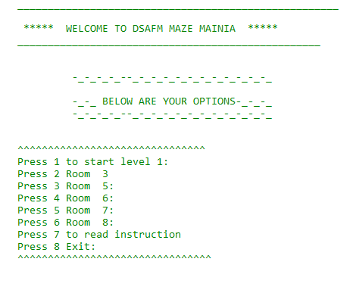
Main menu from code

Slide 8

Dsafm Maze

Slide 9
Algorithm
The algorithm that was used to find the shortness path is Dijkstra’s.
Dijkstra’s algorithm is very similar to Prim’s algorithm for minimum spanning tree. Like Prim’s MST, we generate a SPT (shortest path tree) with given source as root. We maintain two sets, one set contains vertices included in shortest path tree, other set includes vertices not yet included in shortest path tree. At every step of the algorithm, we find a vertex which is in the other set (set of not yet included) and has a minimum distance from the source.

Slide 10
Dsafm maze ‘FINDPLAYER’ FOR LOOP
The FOR LOOP STRUCTURE cycles through the appropriate maze board in order to find the player’s location (‘P’ in maze board array). Once ‘P’ is found its indices are recorded in the ‘playerRow’ and ‘playerCol’ variables; ‘i’ being the index of the Row and ‘i2’ the index of the column.

Slide 11
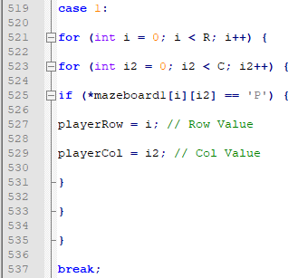
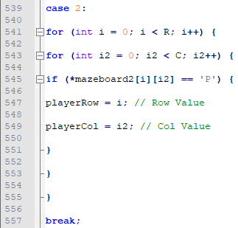
CODE SNIPPET

Slide 12
DSAFM MAZE GAMEFUNCTION NESTED IF-ELSE
The NESTED IF-ELSE statement is the basic function of the game. Firstly, it accepts all the values that the game requires, the game level[which maze board to read from] and the desired location the player would like to move to [row and column values] then performs the necessary checks using the ‘isValid’ and ‘isExit’ functions.

Slide 13
DSAFM MAZE GAMEFUNCTION NESTED IF-ELSE
If ‘isValid’ and ‘isExit’ are both true, the player receives a prompts that they have won and indicating whether they have found the shortest path or not. If ‘isValid’ is true and ‘isExit’ is false, the game moves the player to the new location. If ‘isValid’ is false, the player does not move at all and is prompted to move elsewhere.

Slide 14
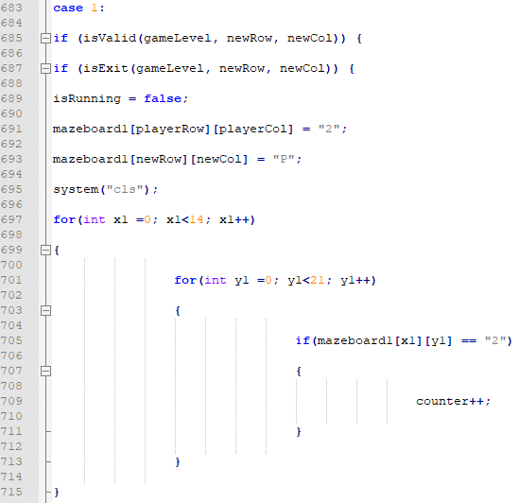
Code snippet

Slide 15
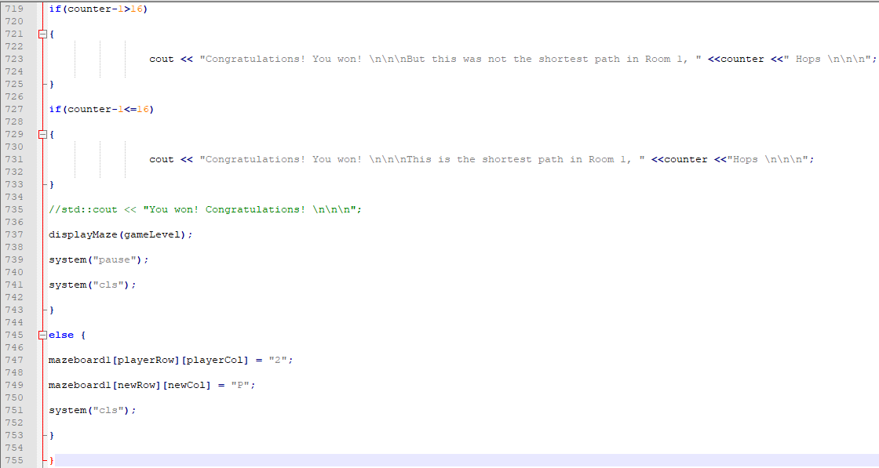
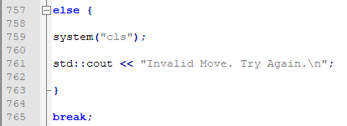
Code snippet con’td

Slide 16
Justification
The following are some justifications for creating and recommending the use of the DSFM’S Mazeboard game.
This program is very efficient in that it allows the equal opportunity of all the players to find the exit in equal amount of chances. More than one exit exists in the maze which will facilitate each player having an equal opportunity to win by finding the shortest path to the exit. Even when the exit is not found right away, the player still has more chances of winning in the game.

Slide 17
Justification
Inefficient of the DSAFM Maze
The run time of the game is inefficient as it takes too long to run (7 secs).
We could have used a counter function that would be able to clear the room once a user enters a new room. We used 5 for loop counters.
The code allows the user to select any room while it should have allow them to complete a room before entering another.
Whenever you re-enter a room after playing the room should rest. However, as the game is it does not refresh, it is stored in memory.

Slide 18
Justification
Inefficient of the DSAFM Maze
The exit does not all you to enter a room whenever you exit. It should be able to allow you to enter another room once you exit.

Slide 19

Dsafm maze
QUESTIONS & ANSWERS

Slide 20

Dsafm maze
WE HOPE YOU WERE A-MAZE-D!!!

